Slide 1
LINKED-LIST

Slide 2
List: List refers to a linear collection of data items.
Link-List: A linked list or a one way list is a linear collection of data elements called nodes, Where the linear order is given by means of pointers.
Each node in the list is divided in two parts: The first part contains the information and the second contains the address of the next node in the list called link field.
Link List Representation:
The Linked List contains a list pointer variable called start pointer which contains the address of the first node in the list.
The null pointer signals the end of the list.
A special case is the list that has no nodes such a list is called the null list or empty list.
Start
INFormation
NULL
LINK

Slide 3
Representation of Linked lists in memory.
Start=4 So info[4]=M
Link[4]=2 so info[2]= C
Link[2]=8 so info[8]=A
Link[8]=NULL
INFO
LINK
1
2 | C
3
4 | M
5
6
7
8 | A
8
2
NULL
4
START

Slide 4
Operation on linked-list:
1) Traversing
2) Insertion
3) Deletion
4) Searching

Slide 5
Traversing a link-list
Algo: Let LIST be a linked list in memory. This algorithm traverse LIST, applying an operation process to each element of LIST. The variable PTR points to the node currently being processed.
1) Set PTR:=Start[Initializes pointer PTR]
2) Repeat Steps 3 and 4 while PTR!=NULL.
3) Apply Process to Info[PTR].
4) Set PTR=Link[PTR] [Ptr now points to the next node]
[End of step 2 loop]
5) Exit

Slide 6
Count the number of nodes in a link-List:
1) Set NUM=0[Initialize counter]
2) Set PTR=Start
3)Repeat steps 4 and 5 while PTR!= NULL
4) Set NUM=NUM+1
5) Set PTR=Link[PTR].
6) Exit

Slide 7
Program to Create a link List:
  struct node
  { int info;
  node *link;
  };
  void main()
  { int item,n,i;
  node *ptr,*START;
  clrscr();
  printf("Enter total nummber of nodes ");
  scanf("%d",&n);
  ptr=new node;
  START=ptr;
for(i=1;i<=n;i++)
{
printf("Enter node number %d of list ",i);
scanf("%d",&item);
ptr->info=item;
if(i==n)
ptr->link=NULL;
else
ptr->link=new node;
ptr=ptr->link;
}
ptr=START;
while(ptr!=NULL)
{
printf("\t%d",ptr->info);
ptr=ptr->link;
}
getch();
}

Slide 8
Searching in Link List:
In linear linked list, only linear search is possible. This is one the limitations of the lists as there is no way to find the location of the middle element of the list. Further the list may be sorted or unsorted.

Slide 9
List is Unsorted
If the list is unsorted, we traverse the list from the beginning and compare each element of the list with the given element, say item, to be searched. If the match occurs, the location of the element is printed, otherwise a message ”Element not found” is printed

Slide 10
ALGORITHM
1) Set PTR=START.
2) Repeat Step 3 While PTR!=NULL
3)if Item = INFO[PTR] then
Set LOC=PTR; and Exit
Else
Set PTR=LINK[PTR]. [Ptr points to next node]
[End while]
4) [Search is unsuccessful] Set LOC=NULL
5) EXIT

Slide 11
List is sorted
If the list is sorted, we traverse the list from the beginning and compare each element of the list with the given element, say item, to be searched. If the match occurs, the location of the element is printed. If we reach the element that is greater than item or end of the list then a message “Element not found” is printed

Slide 12
ALGORITHM
1) Set PTR=START.
2) Repeat Step 3 While PTR!=NULL
3)if Item < INFO[PTR] then
Set PTR=Link[PTR]. [Ptr points to next node]
Else if Item = INFO[PTR]
Set LOC=PTR; and Exit
Else
Set LOC=NULL and Exit
[End while]
4) Set LOC:=NULL
5) Exit

Slide 13
Inserting an Element
To insert an element in the linked list, the first task is to get a free node, assign the element to be inserted to the info field of the node And then new node is placed at the appropriate position by adjusting the appropriate pointer. The insertion in the list can take place at following positions:-
At the beginning of the list
At the end of the list
After a given element

Slide 14
Insertion at the beginning of the list
To insert at the beginning of list, first of all we test whether the linked list is initially empty. If yes, then the element is inserted at the first and the only element of the list by performing the following steps.
Assign NULL value to the link field of the new node
Assign address of the new node to START

Slide 15
However if the list is not empty then element is inserted as the first element of the list by performing the following steps
Assign value of START to the link field of new node
Assign address of the new node to START

Slide 16
The following function shows the various steps
required to accomplish this task.
void insert_beg(int item)
{
node *ptr;
ptr = new node;
ptr->info=item;
if(START==NULL)
ptr->link= NULL;
else
ptr->link= START;
START=ptr;
return;
}

Slide 17
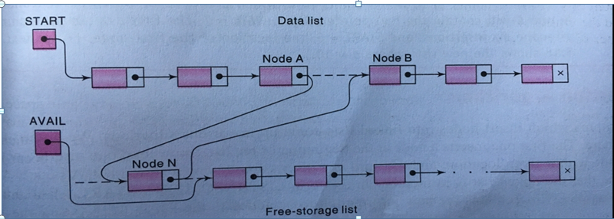

Slide 18
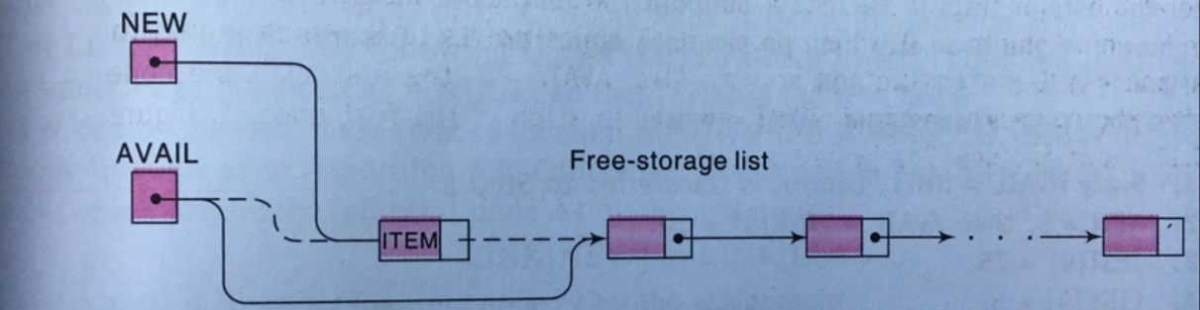
NEW:=AVAIL, AVAIL:=LINK[AVAIL]
INFO[NEW]:=ITEM

Slide 19
INSFIRST(INFO, START, AVAIL, ITEM)
This algorithm inserts ITEM as the first node in the list.
1. [OVERFLOW?] If AVAIL=NULL then Write Overflow and Exit
2. Set NEW:=AVAIL AND AVAIL=LINK[AVAIL]
3. Set INFO[NEW]=ITEM
4. Set LINK[NEW]=START
5. Set START:=NEW
6. Exit

Slide 20
Insertion at the end of the list
To insert at the end of list, first of all we test whether the linked list is initially empty. If yes, then the element is inserted at the first and the only element of the list by performing the following steps.
Assign NULL value to the link field of the new node
Assign address of the new node to START

Slide 21
However if the list is not empty then the list is traversed to reach the last element and then the element is inserted as the last element of the list by performing the following steps
Assign NULL value to the link field of new node
Assign address of the new node to the link field of the last node.

Slide 22
The following function shows the various steps
required to accomplish this task.
void insert_end(int item)
{
node *ptr, *loc;
ptr = new node;
ptr->info=item;
Ptr->link=NULL;
if(START==NULL)
START= ptr;

Slide 23
else
{
loc = START;
while(loc->link != NULL)
loc = loc->link;
loc->link = ptr;
}
return;
}

Slide 24
Insertion after the given element
To insert the new element after the given element, first of all, we find the location(loc) of the given element in the list and then the element is inserted in the list by performing the following steps
Assign the link field of the node pointed by loc to the link field of the new node
Assign the address of new node to the link field of the node pointed by loc

Slide 25
void insert_after(int item, int after_item)
{
node *ptr,*loc;
loc = search(after_item);
if(loc==NULL)
{
cout<< The element is not present after which you want to insert the new item<<endl;
}

Slide 26
else
{
ptr=new node;
ptr->info=item;
ptr->link= loc->link;
loc->link=ptr;
return;
}
}

Slide 27
Deleting an Element
To delete an element from list, first the pointers are set properly and then the memory occupied by the node to be deleted is deallocated (freed). The deletion can take place at following positions:-
At the beginning of list
At the end of list
After the given element

Slide 28
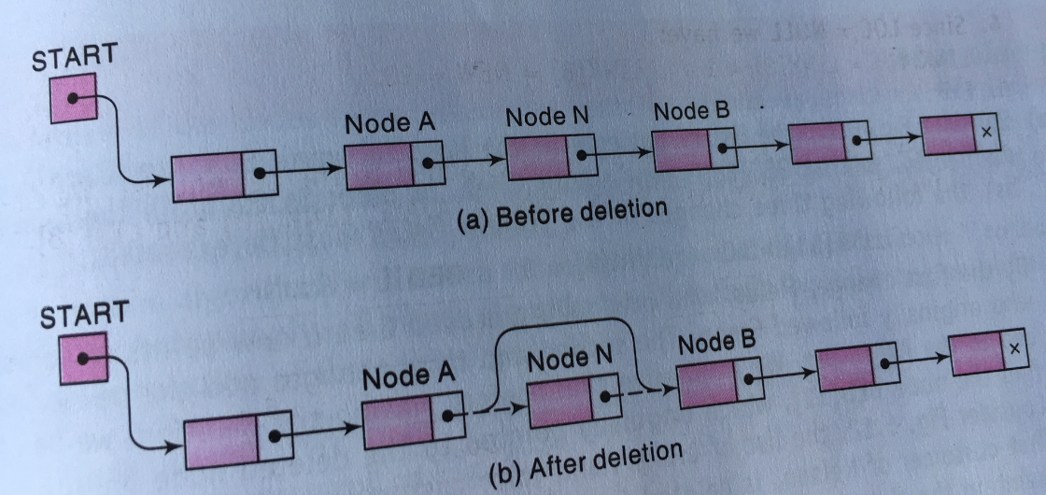

Slide 29
Deleting form the beginning of list
An element can be deleted by performing the following steps:-
Assign the link field of the first node to the START.
Deallocate the memory occupied by the node pointed to by ptr.

Slide 30
void del_beg()
{
if(START==NULL)
{
cout<<“ The list is empty”<<endl;
return;
}
else
{
ptr = START;
START = START ->link;
free(ptr);
cout<<“ the first element is deleted”<<endl;
return;
}

Slide 31
Deletion from the end of list
To delete the last element from the list, first we traverse to the second last element of the list, then the last element is deleted by performing the following steps:-
Assign the link field of the second last node to a temporary var, say ptr.
Assign value NULL to the link filed of the second last node of the list.
Deallocate the memory occupied by the node pointed to by ptr

Slide 32
void del_end()
{
node *ptr, *loc;
if(START==NULL)
{
cout<<“ The list is empty”<<endl;
return;
}
else if(START->link==NULL)
{
ptr = START;
START = NULL;
free(ptr);
}

Slide 33
else
{
loc=START; // Address of first node
ptr= START->LINK; // Address of second node
while(ptr->link!=NULL)
{
loc=ptr;
ptr=ptr->link;
}
loc->link = NULL;
cout<<“ the last node is deleted”<<endl;
return;
}

Slide 34
Deletion after the given element of list
To delete an element after a given element, we find the location, loc of the element after which the element to be deleted comes. Then the element is deleted by performing the following steps:-
Assign the link field of the node pointed by loc to a temporary var, say ptr.
Assign the link field of the node to be deleted to the link field of the node pointed by loc
Deallocate the memory occupied by the node pointed to by ptr

Slide 35
void del_after_element(int after_item)
{
node *ptr, *loc;
loc= search(after_item);
if(loc==NULL)
{
cout<<“ The element after which you want to delete is
not present in the list”<<endl;
return;
}
else
{
ptr = loc->link;
loc>link= ptr->link;;
free(ptr);
cout<<“ the element is deleted”<<endl;
return;
}

